Slide 1

Be Hurricane Season Savvy…
Preparedness Tips from FLAPDAN
Get a Kit
Know Your Zone
Tens of Miles or Hundreds of Miles?
Special Needs?
Prep for Pets
More info >>>

Slide 2
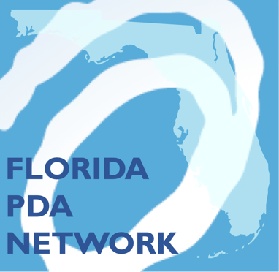
Did You Know…
FLAPDAN is the “Florida Presbyterian Disaster Assistance Network” and we are partners with your presbytery and PDA.

Slide 3
FLAPDAN’s Mission:
To support Florida communities through disaster preparedness, response and recovery by working in partnership with churches and community, government, and faith-based organizations.

